Slide 1
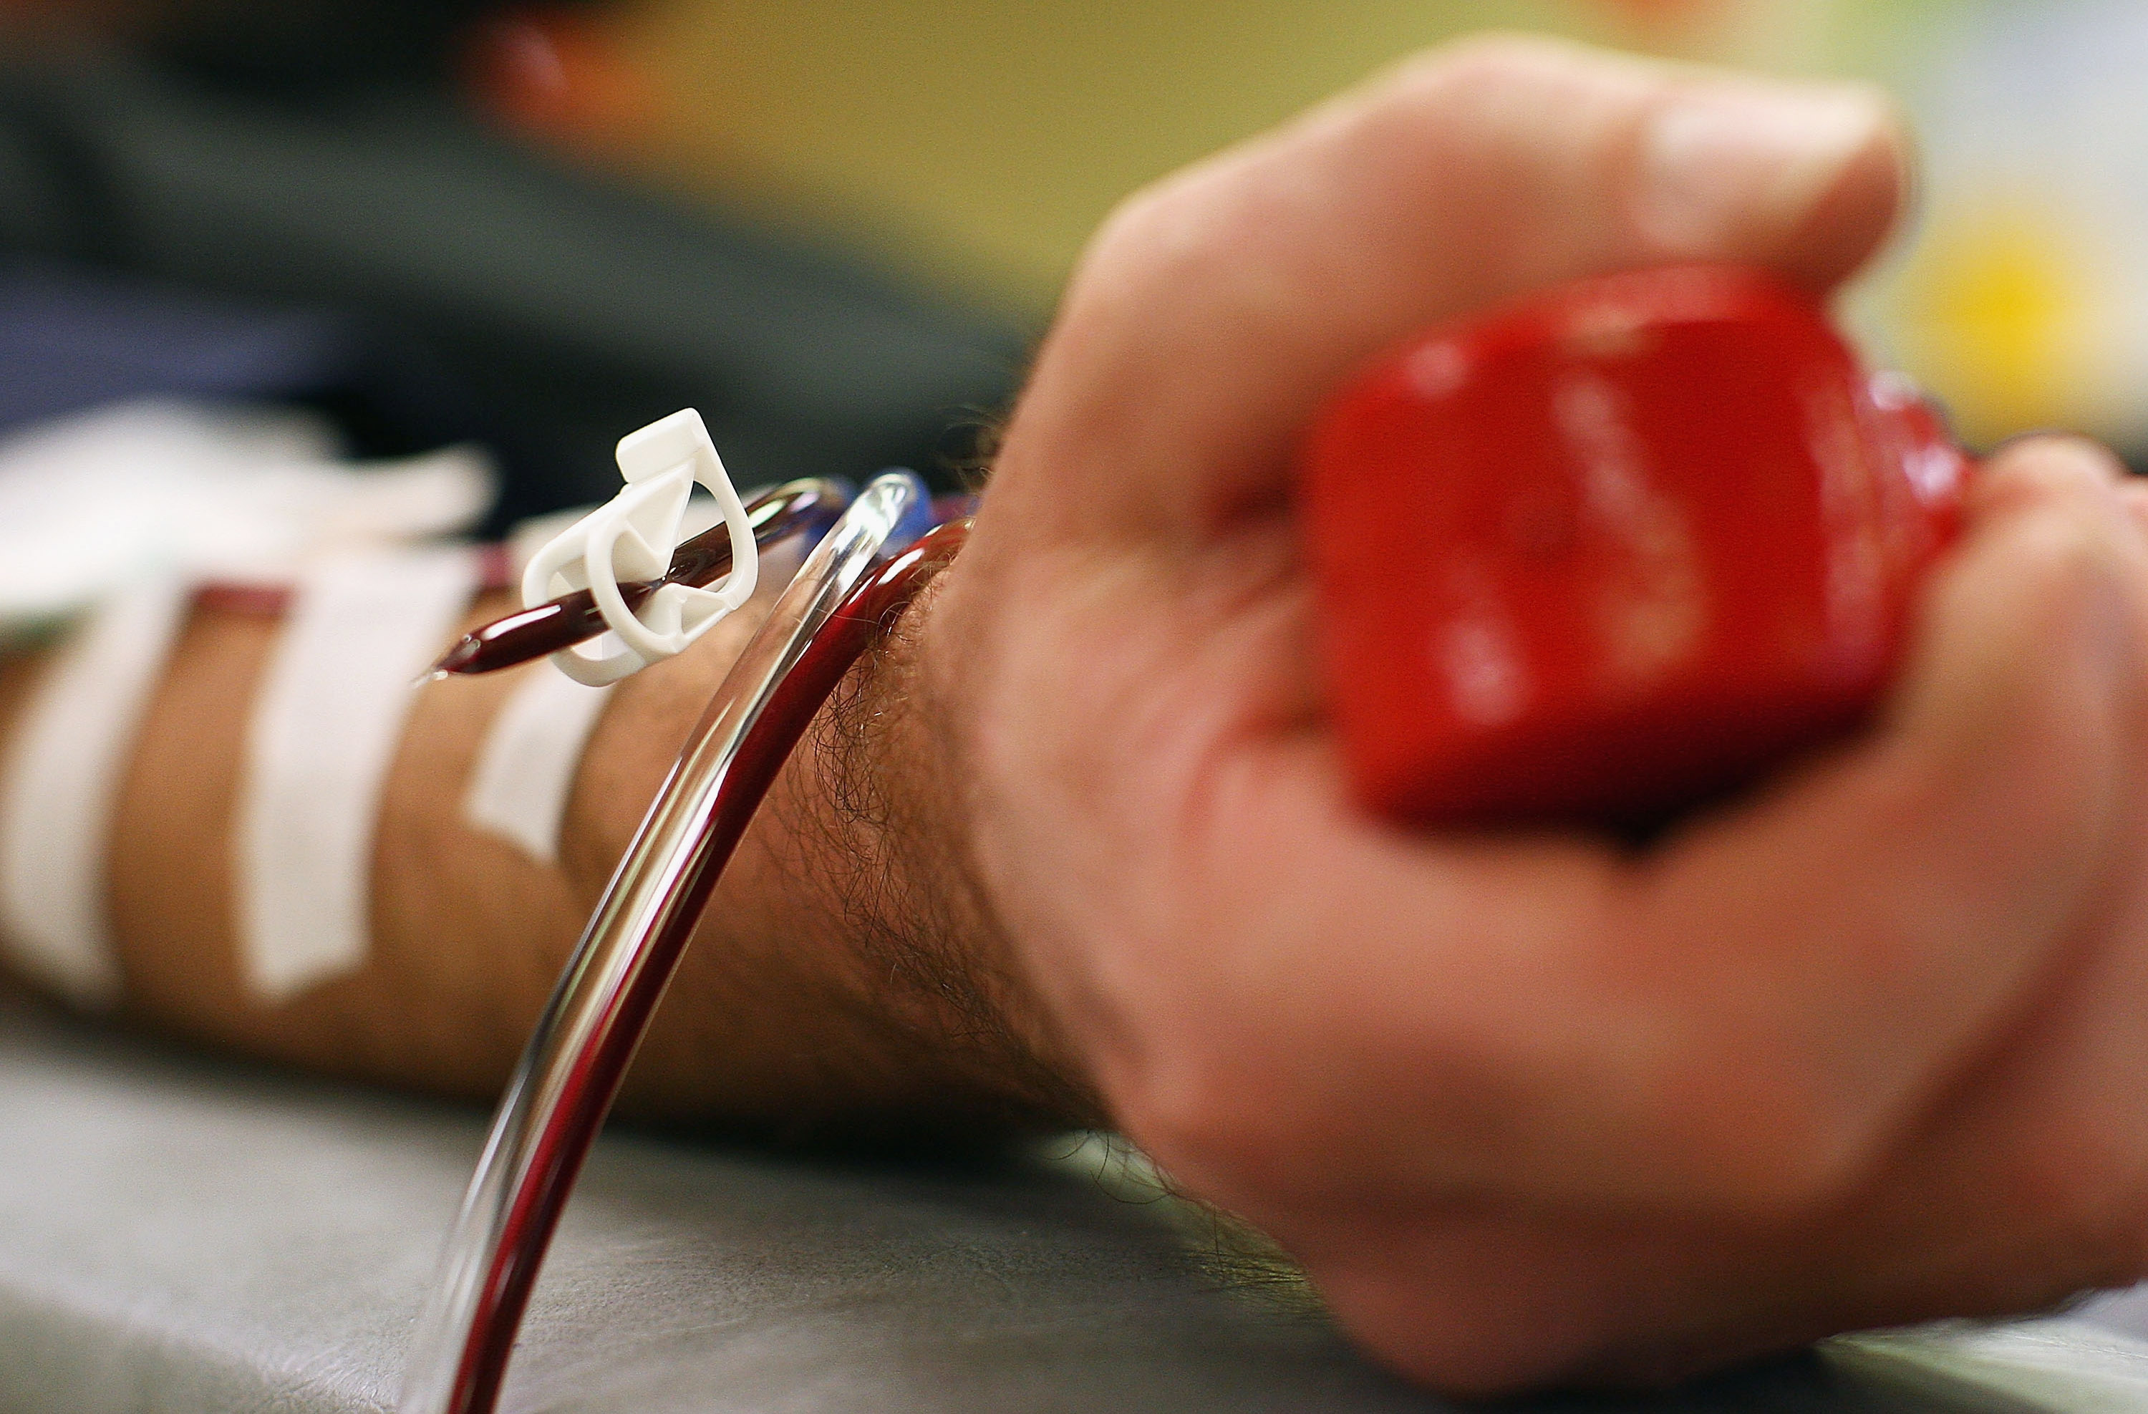
Udonors: automated blood donor recruitment system

Slide 2
Every 2sec someone needs blood
90% of people eligible to donate blood are not doing so
Almost 80% agree to donate if they be asked
http://www.redcrossblood.org/learn-about-blood/blood-facts-and-statistics
http://www.euro.who.int/en/health-topics/Health-systems/blood-safety/data-and-statistics

Slide 3
User stories
I have no time or ability
I am afraid it’s not safe
I am not motivated to do it
My impact is not obvious

Slide 4


Our solution
Web (knowledge) system
Bot platform

Slide 5
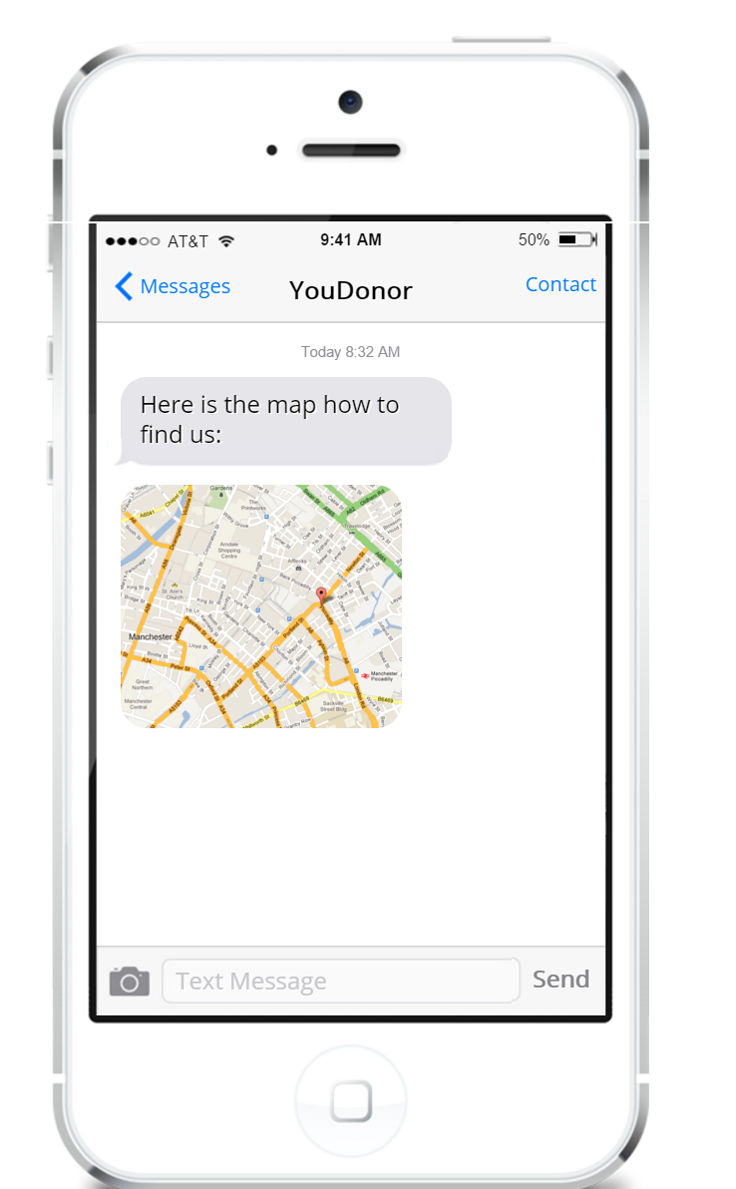
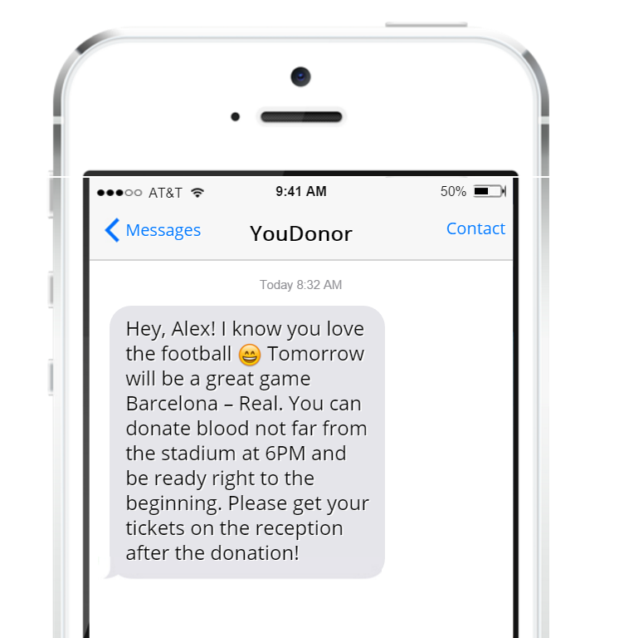
Lack of motivation

Slide 6
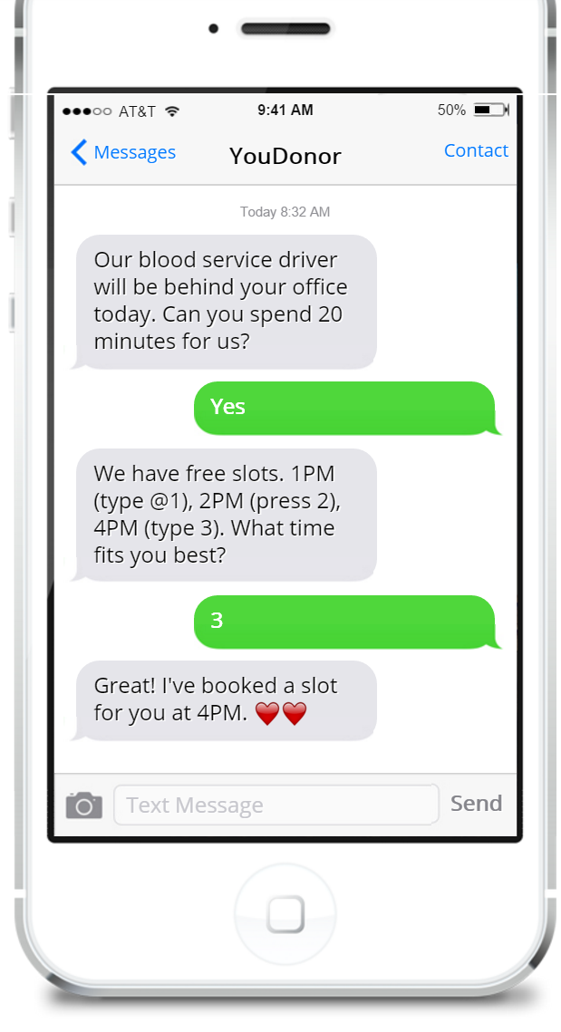
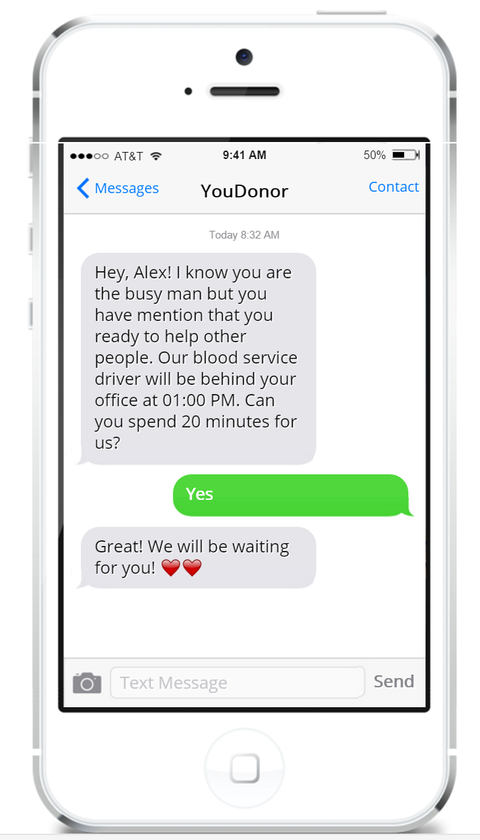
Lack of ability

Slide 7
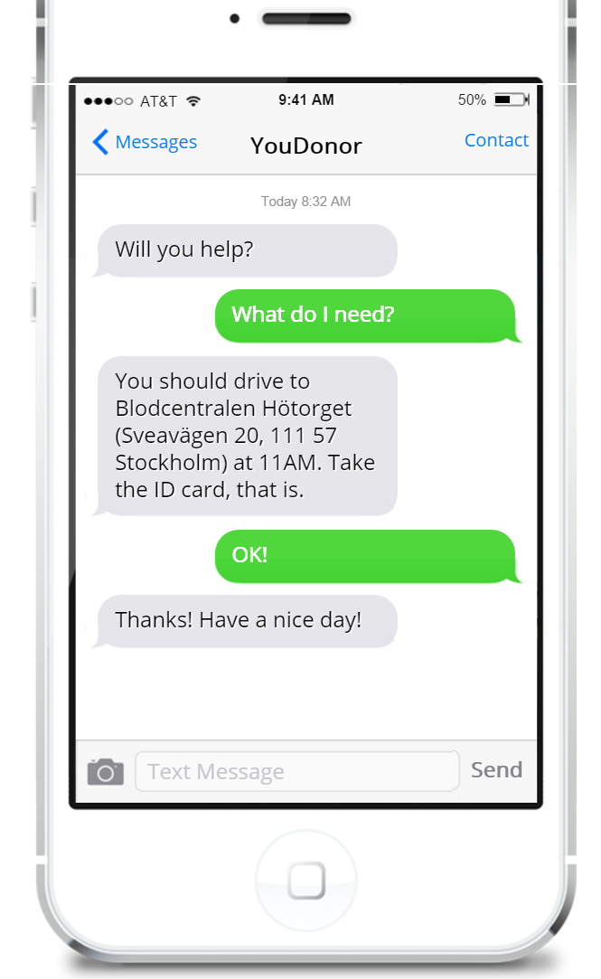
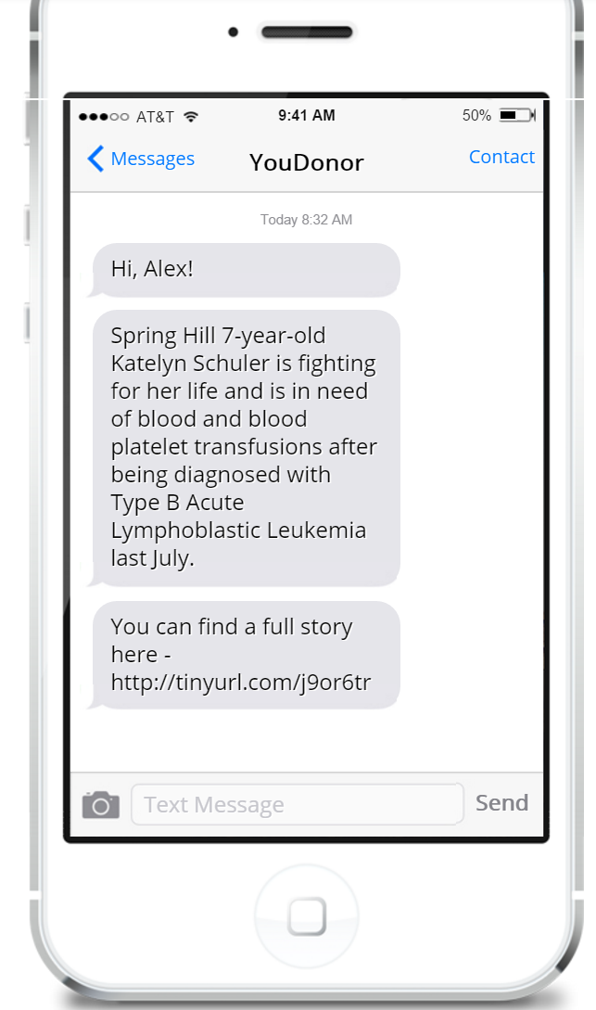
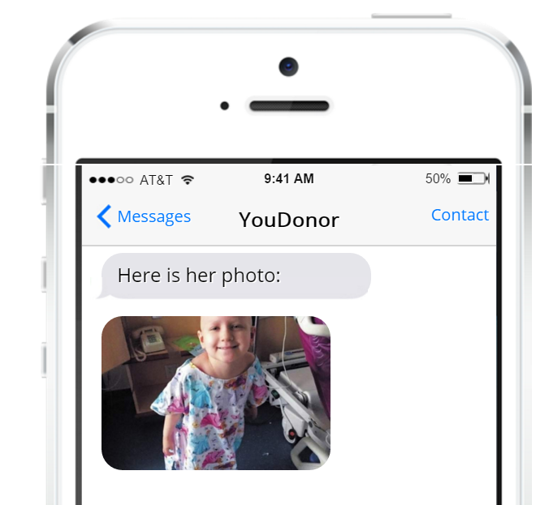
Lack of personalization and direct impact

Slide 8

Why bots?
Easy to program!
Easy to use!
Familiar UX/UI!
We can use current messengers/social networks!
“Facebook’s Messenger Bot Store could be the most important launch since the App Store” – TechCrunch states.

Slide 9
Industry Statistics & Market Size
36,000
Units of red blood cells are needed every day in the U.S.
$24bn
Annual revenue
2.8%
Growth
Blood & Organ Banks Market Research Report | NAICS 62199 | Oct 2015
http://www.ibisworld.com/industry/default.aspx?indid=1582

Slide 10
Business model
Direct sales to NGOs, Red Cross, government health institutions for conducting special campaigns or using our system on top of existing ones.
It can be subscription model (pay monthly and use) or recruitment-based ($N/recruitment, recruit as many donors as you need).

Slide 11
Competitors
Traditional ways of recruitment: TV, offline advertisement, thematic groups, blogs etc.

Slide 12
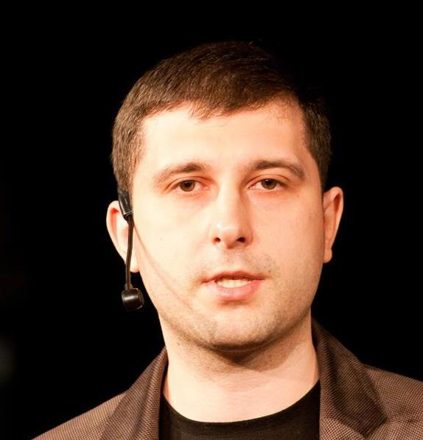
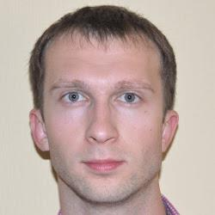
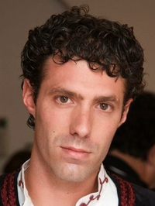
Team
Oleksandr Krakovetskyi
Founder
Mykhailo Galushko
Co-founder
Diego De Jodar Montesinos
External Adviser

Slide 13
Financial projections / timeline
MVP – Q2 2016
Beta launching – Q3 2016
Integration with Ukrainian blood donation system and Kyiv Smart City services – Q4 2016
Global launch – mid 2017

Slide 14
What we are looking for?
$110k for creating a prototype (4-6 months)
Partners in eHealth (Red Cross, UBS etc.)
Startup advisers
Representatives in different regions for local market research

Slide 15


